Slide 1
Modelling Time Series Data with Theano
INSTRUCTOR NAME
Certified Instructor, NVIDIA Deep Learning Institute
NVIDIA Corporation
DATE

Slide 2
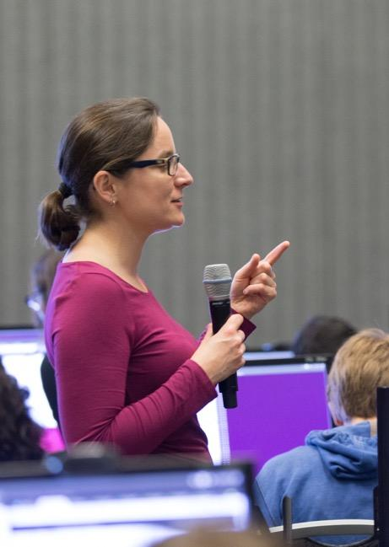
DEEP LEARNING INSTITUTE
DLI Mission
Helping people solve challenging problems using AI and deep learning.
Developers, data scientists and engineers
Self-driving cars, healthcare and robotics
Training, optimizing, and deploying deep neural networks
Notes:
People = Developers, Data Scientist, Engineers
Problems = Self-driving cars, healthcare issues like cancer detection, consumer services and robotics
AI / Deep Learning = training, optimizing and deploying deep neural networks

Slide 3
Lab Perspective
RNNs / LSTMs
Keras / Theano
Pandas / Numpy / Matplotlib
Lab
Discussion / Overview
Launching the Lab Environment
Lab Review
topics

Slide 4
LAB PERSPECTIVE

Slide 5
PURPOSE / GOAL
Predict severity of illness in patients based on information found in electronic health records (EHRs)
Provide feedback to clinicians when trying to assess the impact of treatment decision or raise early warning signs to flag

Slide 6
WHAT THIS LAB IS
Discussion on the tools, techniques and processes commonly used to build RNN / LSTM networks to evaluate EHRs
Introduction to aspects of RNNs, LSTMs, Keras, Theano, Pandas, Numpy and Matplotlib
Guided, hands-on exercise using the tools noted above to build a LSTM network to evaluate EHRs

Slide 7
WHAT THIS LAB IS NOT
Introduction to machine learning from first principles
Explanation of electronic health records
Rigorous mathematical formalism of neural networks
Survey of all the features and options of Keras / Theano

Slide 8
ASSUMPTIONS
You are familiar with:
Concept of electronic health records
Basics of neural networks
Basics of Pandas, Numpy and Matplotlib
Helpful to have:
Familiarity with recurrent neural network (RNNs)

Slide 9
TAKE AWAYS
Ability to setup your own recurrent neural network workflow using Keras / Theano and adapt it to your use case
Know where to go for more info on RNNs, Keras and Theano
Familiarity with data preparation process using Pandas, Numpy and Keras

Slide 10
RNN / LSTM

Slide 11
RECURRENT NEURAL NETWORK
RNN = Recurrent Neural Network
Similar to traditional feed-forward network
RNNs include previous output state
Limited to looking back only a few steps due to vanishing gradient
Errors are backpropagated through time
Inputs from previous time steps get exponentially down weighted and are eventually driven to zero

Slide 12

RNN

Slide 13
LONG SHORT TERM MEMORY
LSTM = Long Short Term Memory
Variant of RNN
No vanishing gradient problem
LSTMs can learn “very deep” tasks that require memories of events that happened or millions of discrete time steps ago
At each time step a measurement is recorded and used as input into the LSTM to yield a probability of survival prediction
Enables a real time monitoring of the patients probability of survival and insight into the patients trajectory

Slide 14
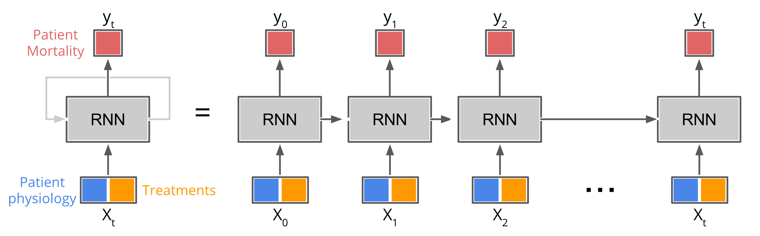
KERAS RNN

Slide 15
KERAS / THEANO

Slide 16
KERAS
Modular neural network written in Python
Runs on TensorFlow and Theano
Theano excels at RNNs / LSTMs
Keras library allows for easy and fast prototyping
Runs on GPUs and CPUs
Compatible with Python 2.7 – 3.5

Slide 17
THEANO
Theano excels at RNNs in general and LSTMs in particular
“Theano is a Python library that allows you to define, optimize, and evaluate mathematical expressions involving multi-dimensional arrays efficiently” (http://deeplearning.net/software/theano/)
Runs on either GPU or CPU architectures

Slide 18
PANDAS / NUMPY / MATPLOTLIB

Slide 19
PANDAS
Used in academia and commercial domains
Open-source, BSD-licensed project
Fast and efficient DataFrame object for data manipulation with integrated indexing
Contains tools for reading and writing data between in-memory data structures and different formats such as:
CSV and text files
Microsoft Excel
SQL databases
HDF5

Slide 20
NUMPY
NumPy is a Python scientific computing package
Open-source software
Includes:
Support for large, N-dimensional arrays and matrices
Collection of high-level mathematical functions

Slide 21
MATPLOTLIB
Matplotlib is a Python 2D plotting library producing publication quality figures
Matplotlib can be used in:
Python scripts
Python and IPython shell
Jupyter notebook
Web application servers
Supports Python version 2.7 – 3.5

Slide 22
LAB DISCUSSION / OVERVIEW

Slide 23
DATA
Electronic health records (EHRs)
Contains medical treatments and histories of patients over time
10 years of data
Data provided by PICU at Children’s Hospital Los Angeles
76,693 observations across 5,000+ unique patient encounters
Data is an irregular time series of measurements taken over the course of a patient’s stay in the ICU

Slide 24
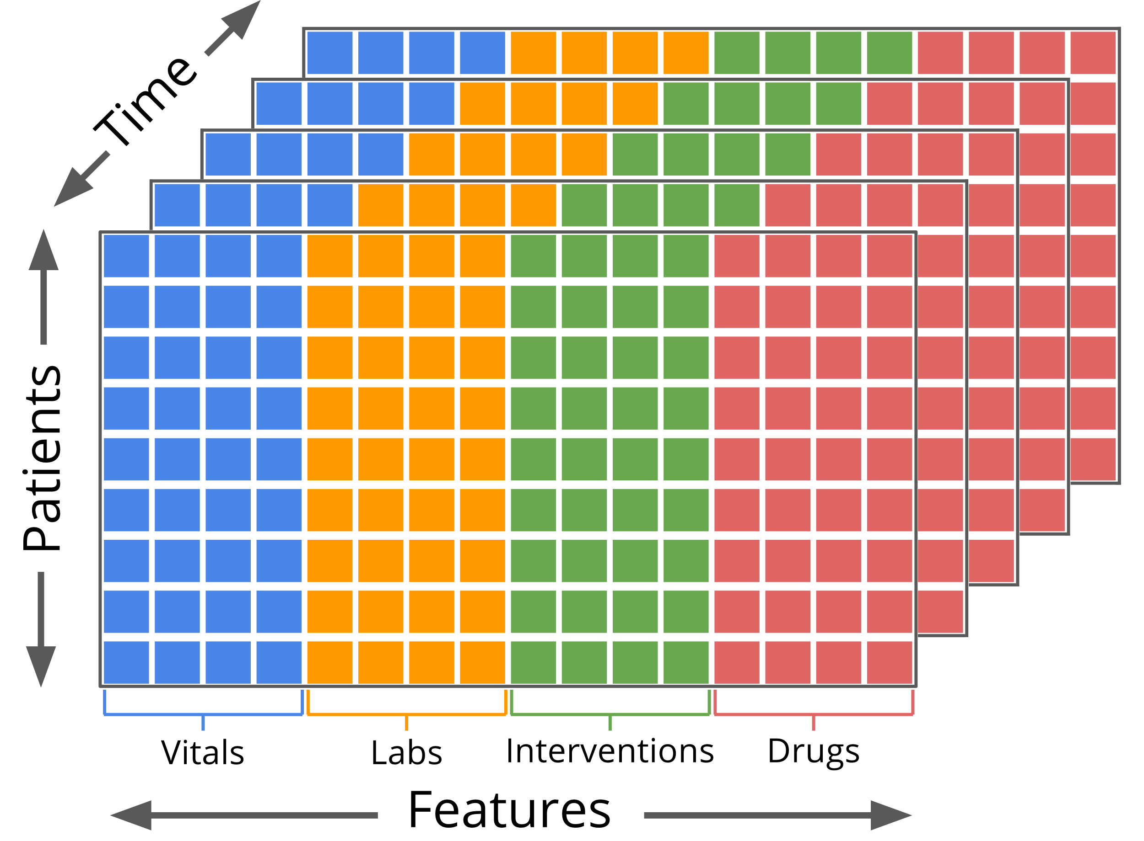
DATA
Measurements include:
Statistics - gender, age, weight
Vitals - heart rate, respiratory rate
Labs – glucose, creatinine
Interventions – intubation, O2
Drugs – dopamine, epinephrine

Slide 25
DATA
Not all measurements were taken for all patients
Dependent variable:
Alive – 1
Not alive – 0
1,113,529 rows containing 265 independent variables
Mean observations per patient encounter = 223
Median observations per patient encounter = 94

Slide 26
DATA
Hierarchical Data Format (HDF) 5
Stores and organizes large amounts of scientific data
Designed by National Center for Supercomputing Applications
API supports most languages
Libraries compatible with Windows, OSX and Linux
Binary format
Not human readable
Efficient in storage size
Scales will to very large operational projects

Slide 27
LAB PROCESS
Setup
Configure Theano options
Import Numpy, Pandas and Matplotlib
Define folders which contain training / testing datasets
Load data using Pandas API

Slide 28
LAB PROCESS
Data Preparation
Data review
Data normalization
Filling data gaps
Data sequencing

Slide 29
LAB PROCESS
Architect LSTM network using Keras and Theano
Build the model (feed data into network for training)
Evaluate model using validation (test) data
Visualize results
Compare baseline to PRISM3 and PIM2

Slide 30
LAB ENVIRONMENT

Slide 31
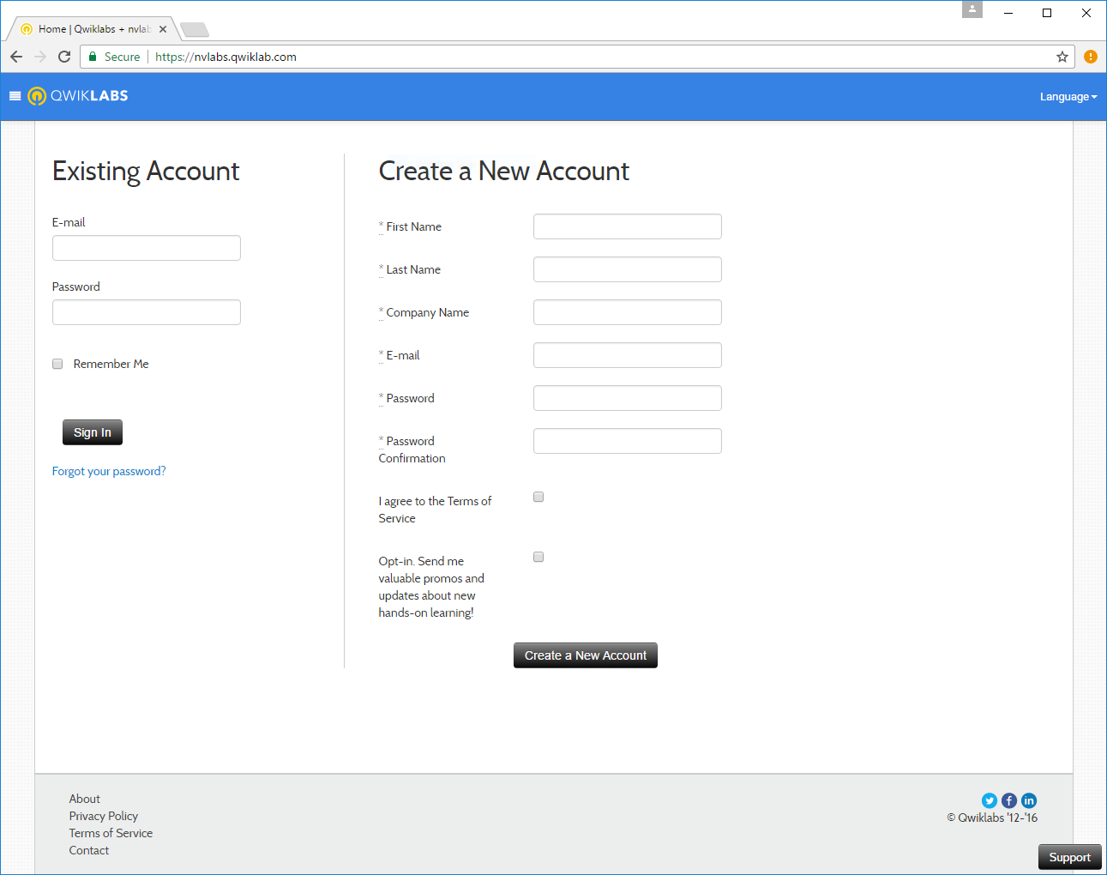
NAVIGATING TO QWIKLABS
Navigate to: https://nvlabs.qwiklab.com
Login or create a new account
Notes:
For client engagements, students should use their work email address to login.

Slide 32
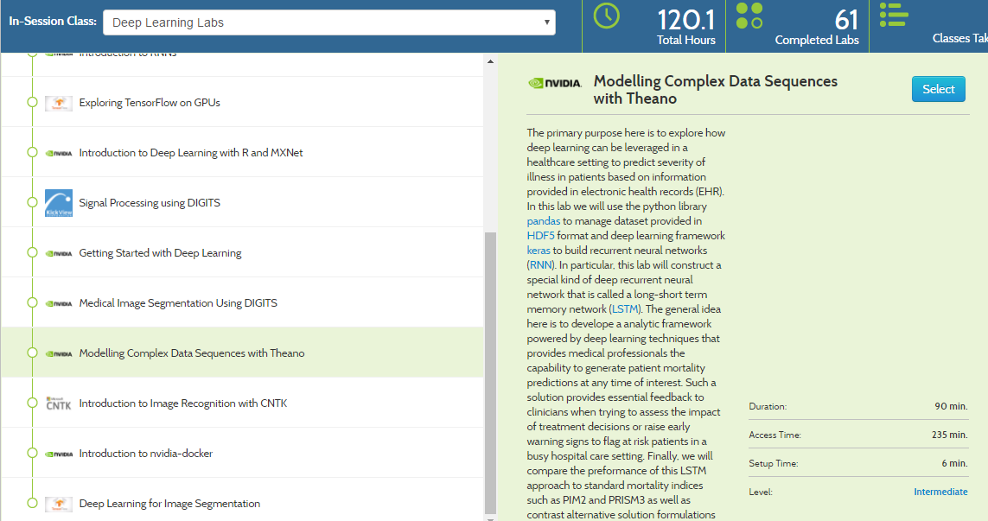
ACCESSING LAB ENVIRONMENT
Click on Modelling Complex Data Sequences with Theano
Then click on Select

Slide 33
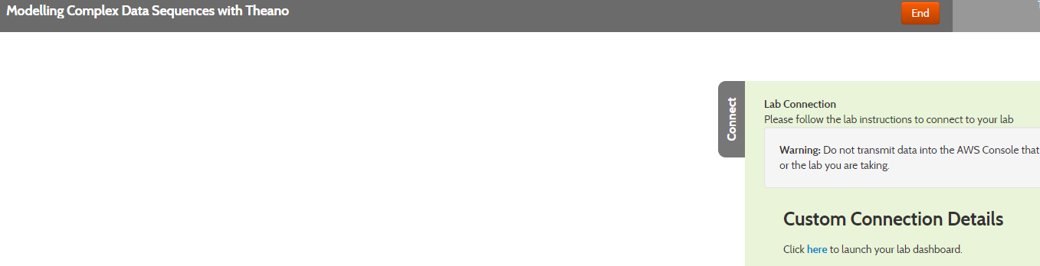
ACCESSING LAB INSTRUCTIONS
Click “Start Lab” to create an instance of the lab environment
Once the lab environment starts, click “here” to access lab instructions (Jupyter notebook)

Slide 34
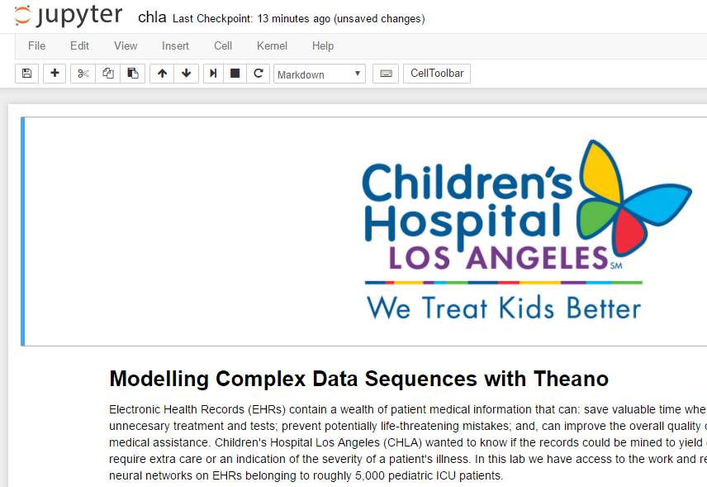
ACCESSING LAB INSTRUCTIONS
Should see Jupyter notebook
Place cursor in code block and click execute button

Slide 35
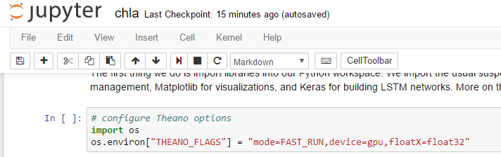
ACCESSING LAB INSTRUCTIONS
Place cursor in code block and click execute button

Slide 36
LAB REVIEW

Slide 37
LAB REVIEW
Setup
Configure Theano options
Import Numpy, Pandas and Matplotlib
Define folders which contain training / testing datasets
Load data using Pandas API

Slide 38
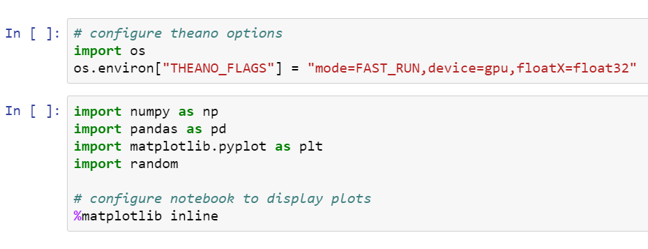
LAB REVIEW - IMPORT LIBRARIES #1B

Slide 39
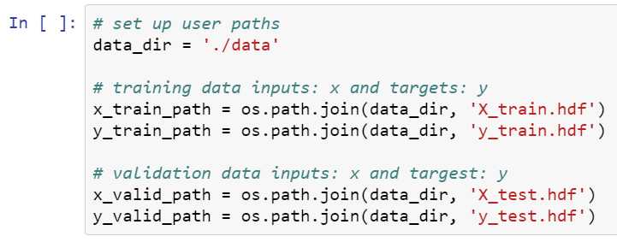
LAB REVIEW - DEFINE PATHS #1C

Slide 40
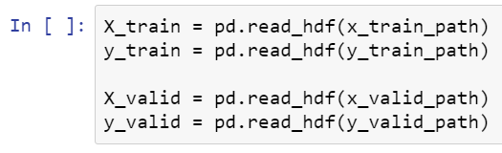
LAB REVIEW - LOAD DATA #1D

Slide 41
LAB REVIEW
Data Preparation
Data review
Data normalization
Filling data gaps
Data sequencing

Slide 42
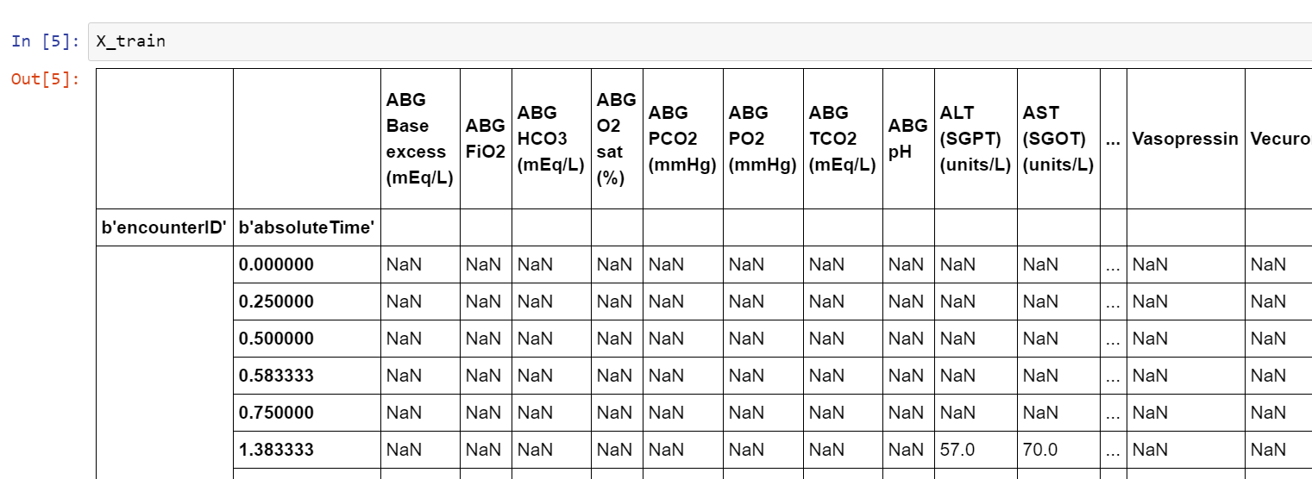
LAB REVIEW – DATA REVIEW #2A

Slide 43
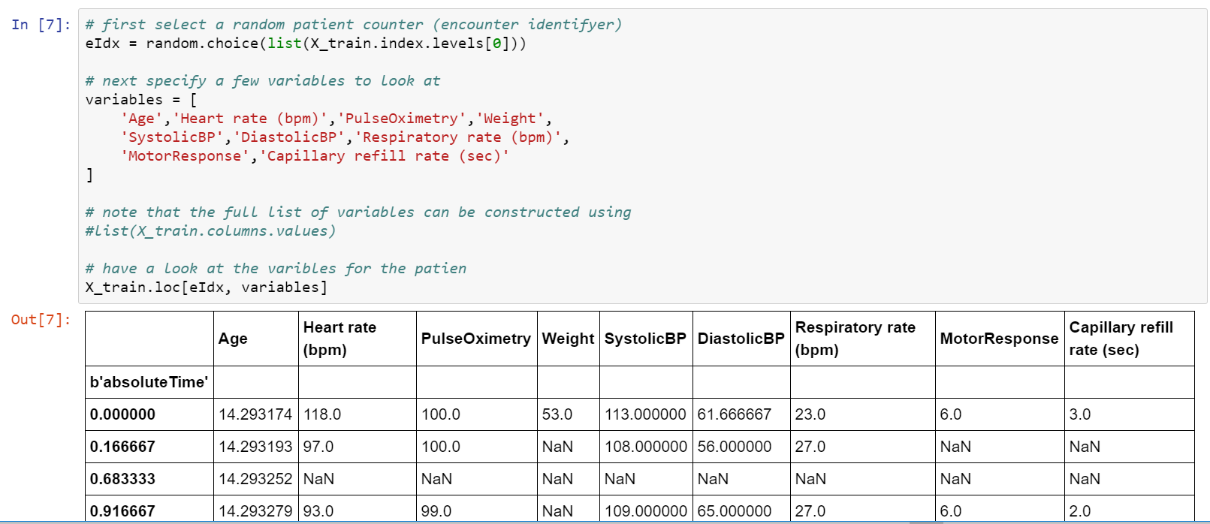
LAB REVIEW – DATA REVIEW #2A

Slide 44
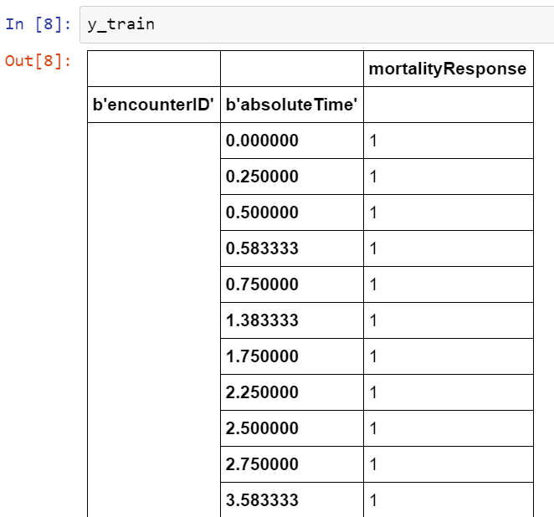
LAB REVIEW – DATA REVIEW #2A

Slide 45
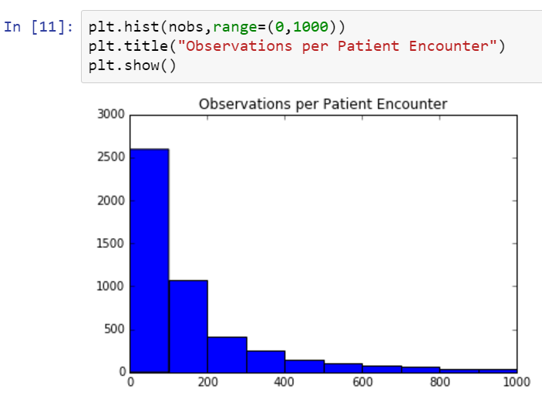
LAB REVIEW – DATA REVIEW #2A

Slide 46
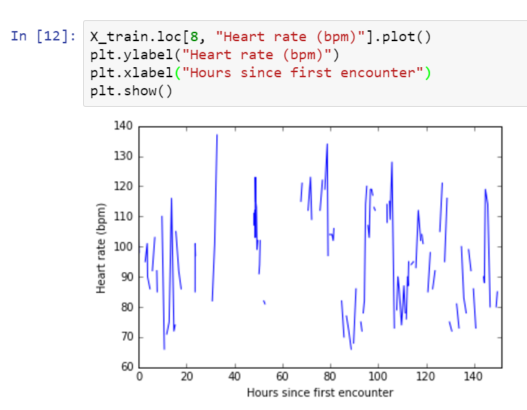
LAB REVIEW – DATA REVIEW #2A

Slide 47
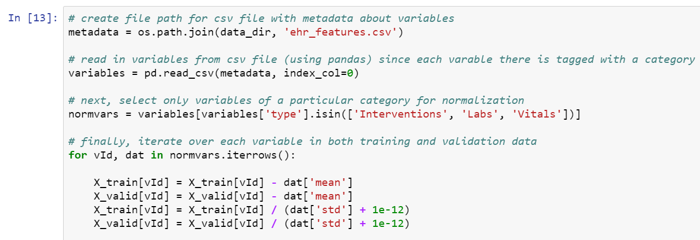
LAB REVIEW - DATA NORMALIZATION #2B

Slide 48
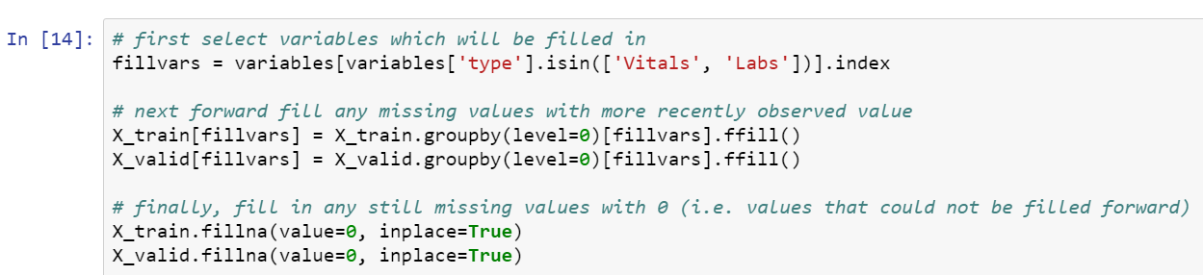
LAB REVIEW - DATA GAPS #2C

Slide 49
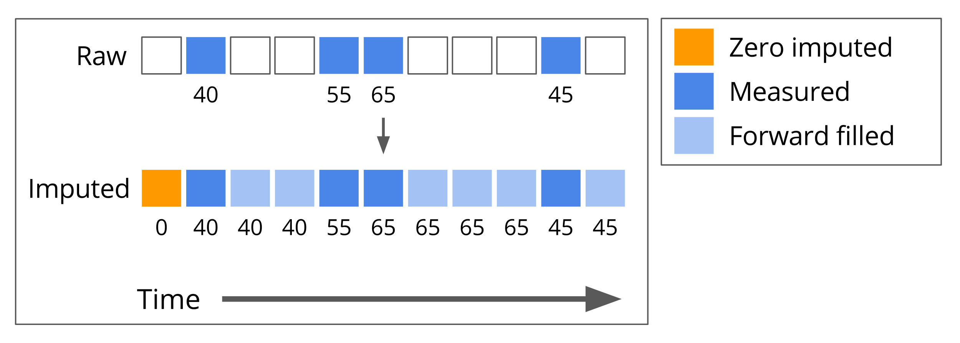
LAB REVIEW - DATA GAPS #2C

Slide 50
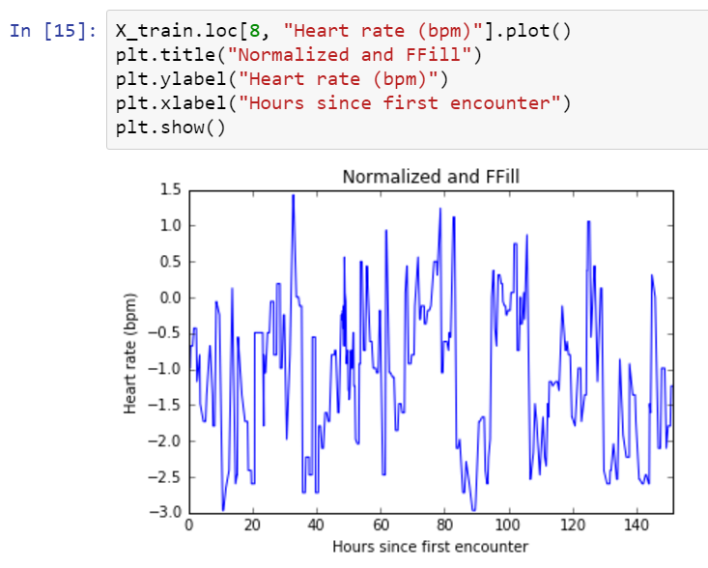
LAB REVIEW - DATA GAPS #2C

Slide 51
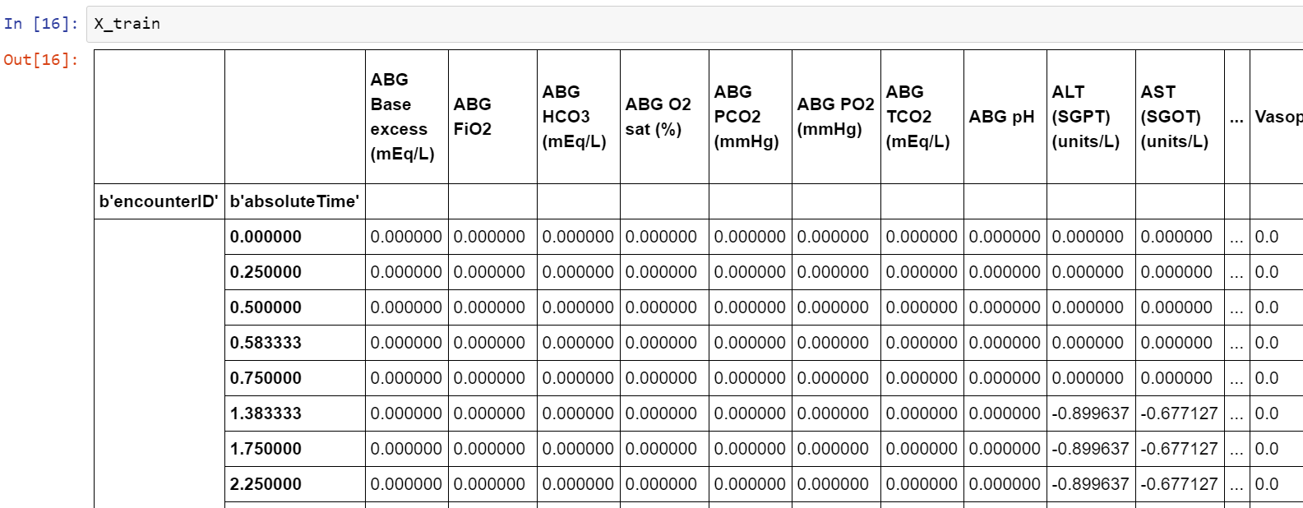
LAB REVIEW - DATA GAPS #2C

Slide 52
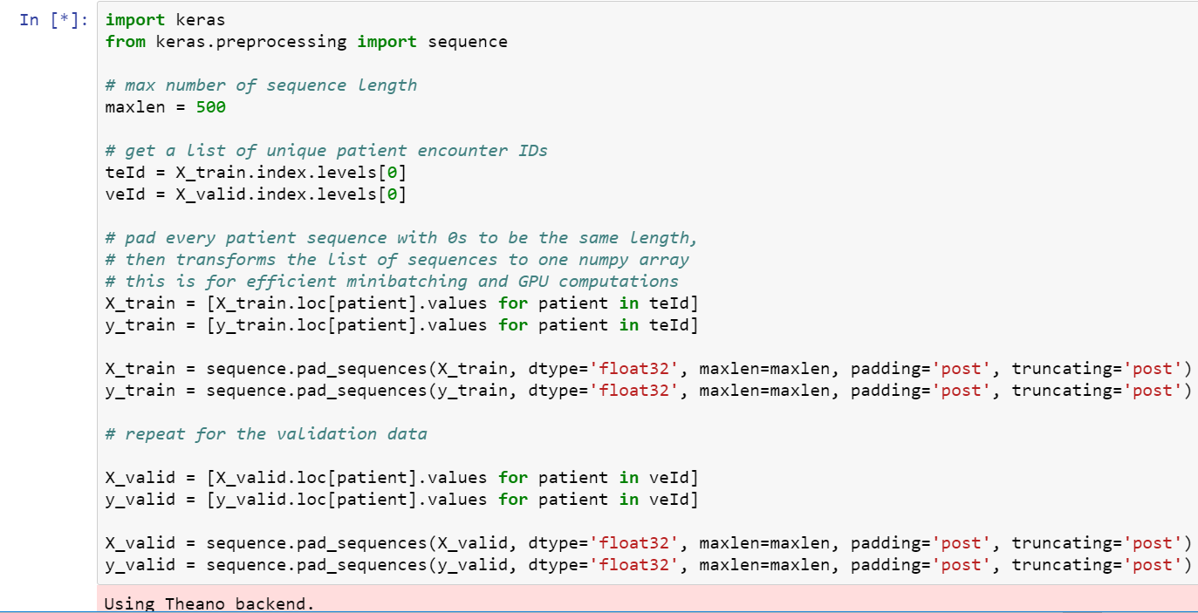
LAB REVIEW - DATA SEQUENCING #2D

Slide 53
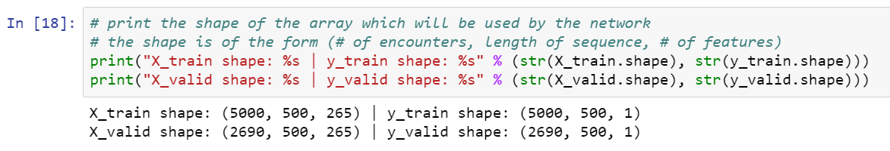
LAB REVIEW - DATA SEQUENCING #2D

Slide 54
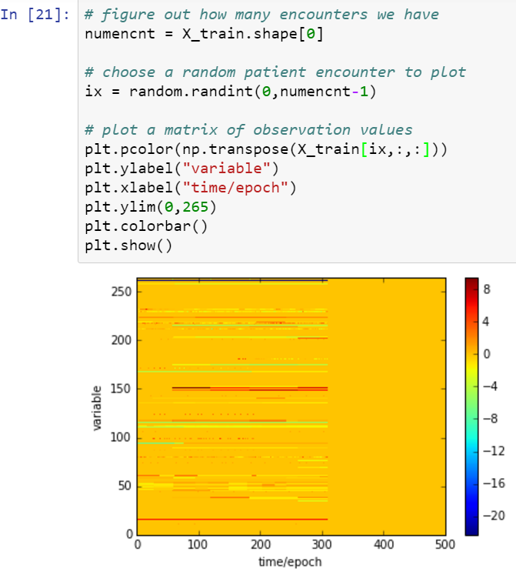
LAB REVIEW - DATA SEQUENCING #2D

Slide 55
LAB REVIEW
Architect LSTM network using Keras and Theano
Build the model (feed data into network for training)
Evaluate model using validation (test) data
Visualize results
Compare baseline to PRISM3 and PIM2

Slide 56
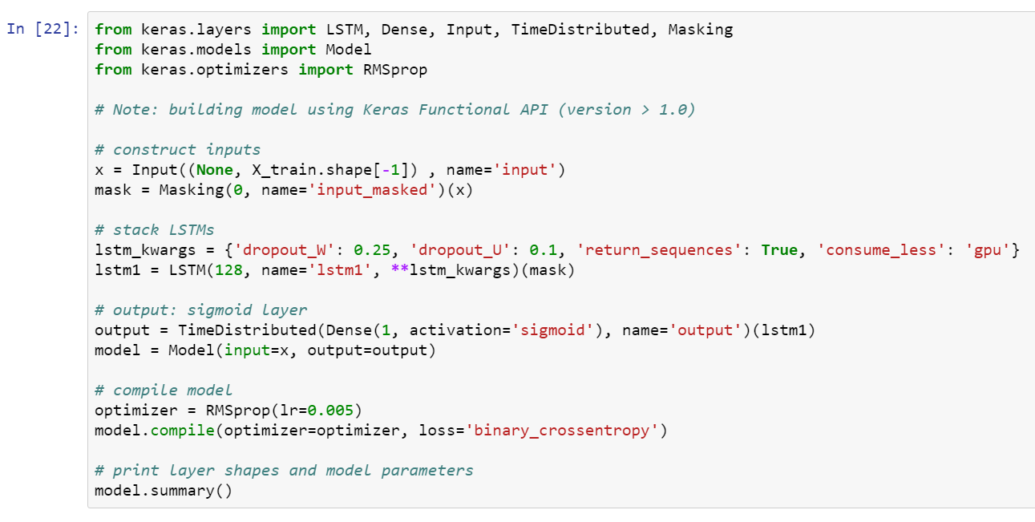
LAB REVIEW - ARCHITECT LSTM #3

Slide 57
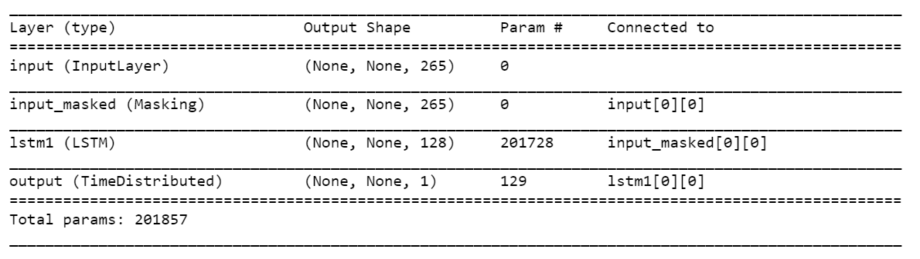
LAB REVIEW - ARCHITECT LSTM #3

Slide 58
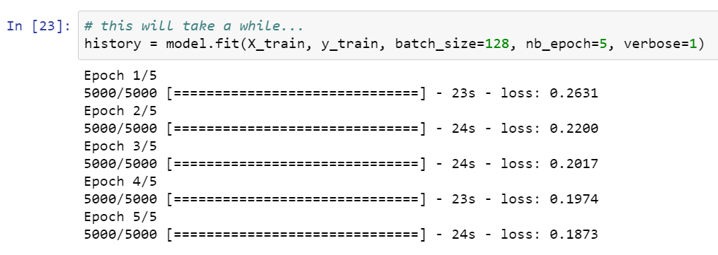
LAB REVIEW – BUILD / TRAIN MODEL #4

Slide 59
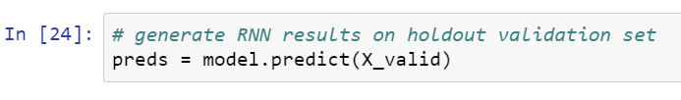
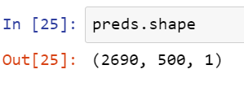
LAB REVIEW – EVALUATE MODEL #5
That is, we have 2690 patient encounters for testing, and at each of the observations the model predicts survivability. Lets plot some predictions!

Slide 60
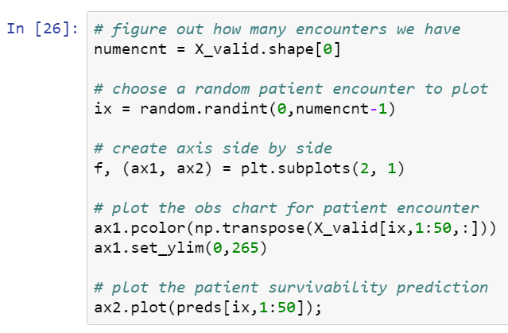
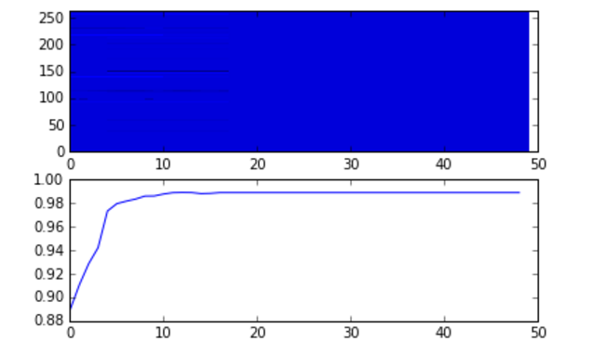
LAB REVIEW - VISUALIZE RESULTS #6

Slide 61
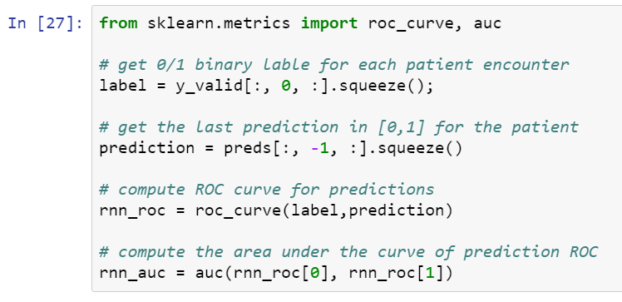
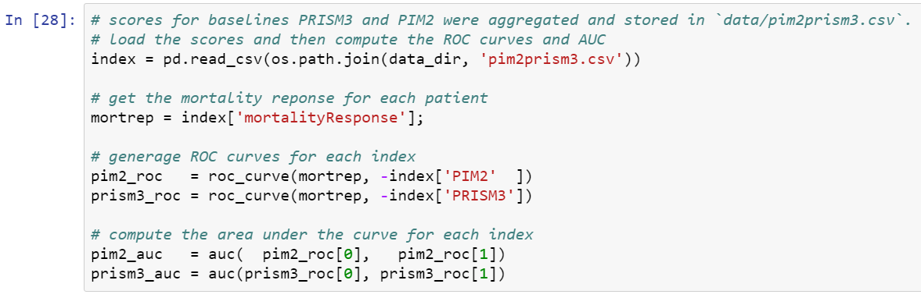
LAB REVIEW - COMPARE BASELINE #7

Slide 62
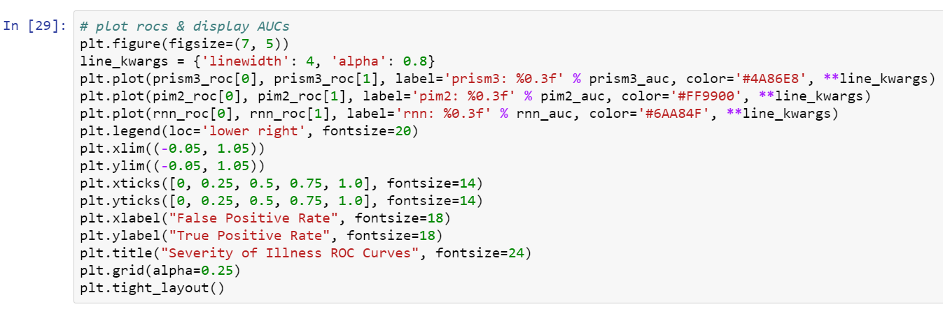
LAB REVIEW - COMPARE BASELINE #7

Slide 63
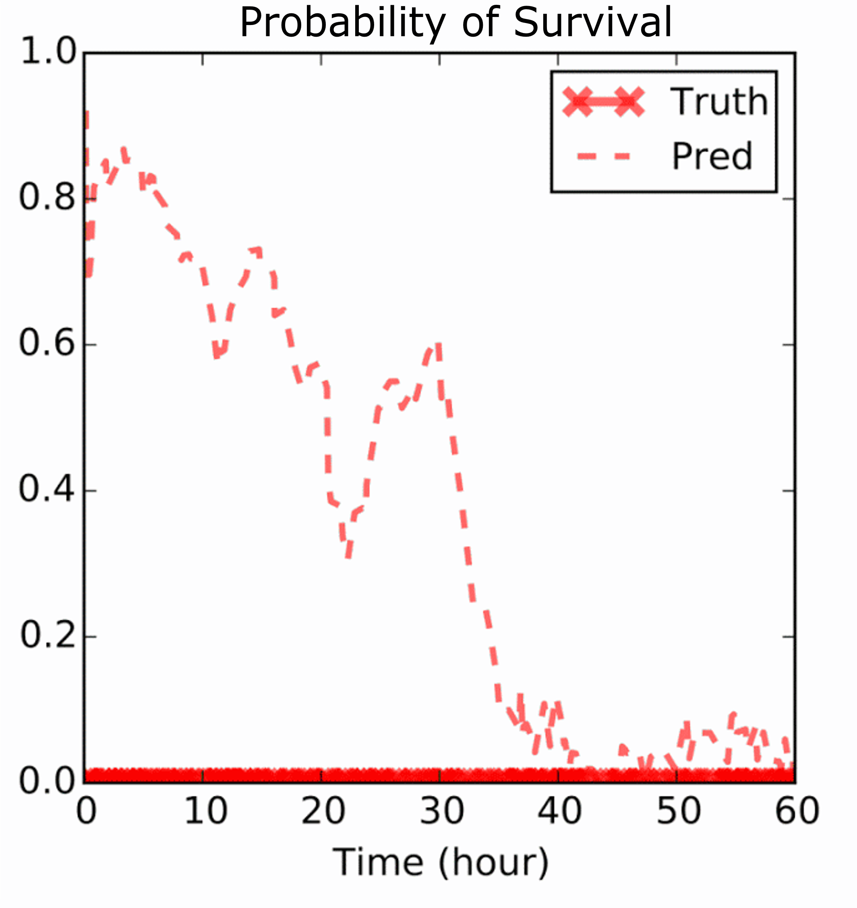
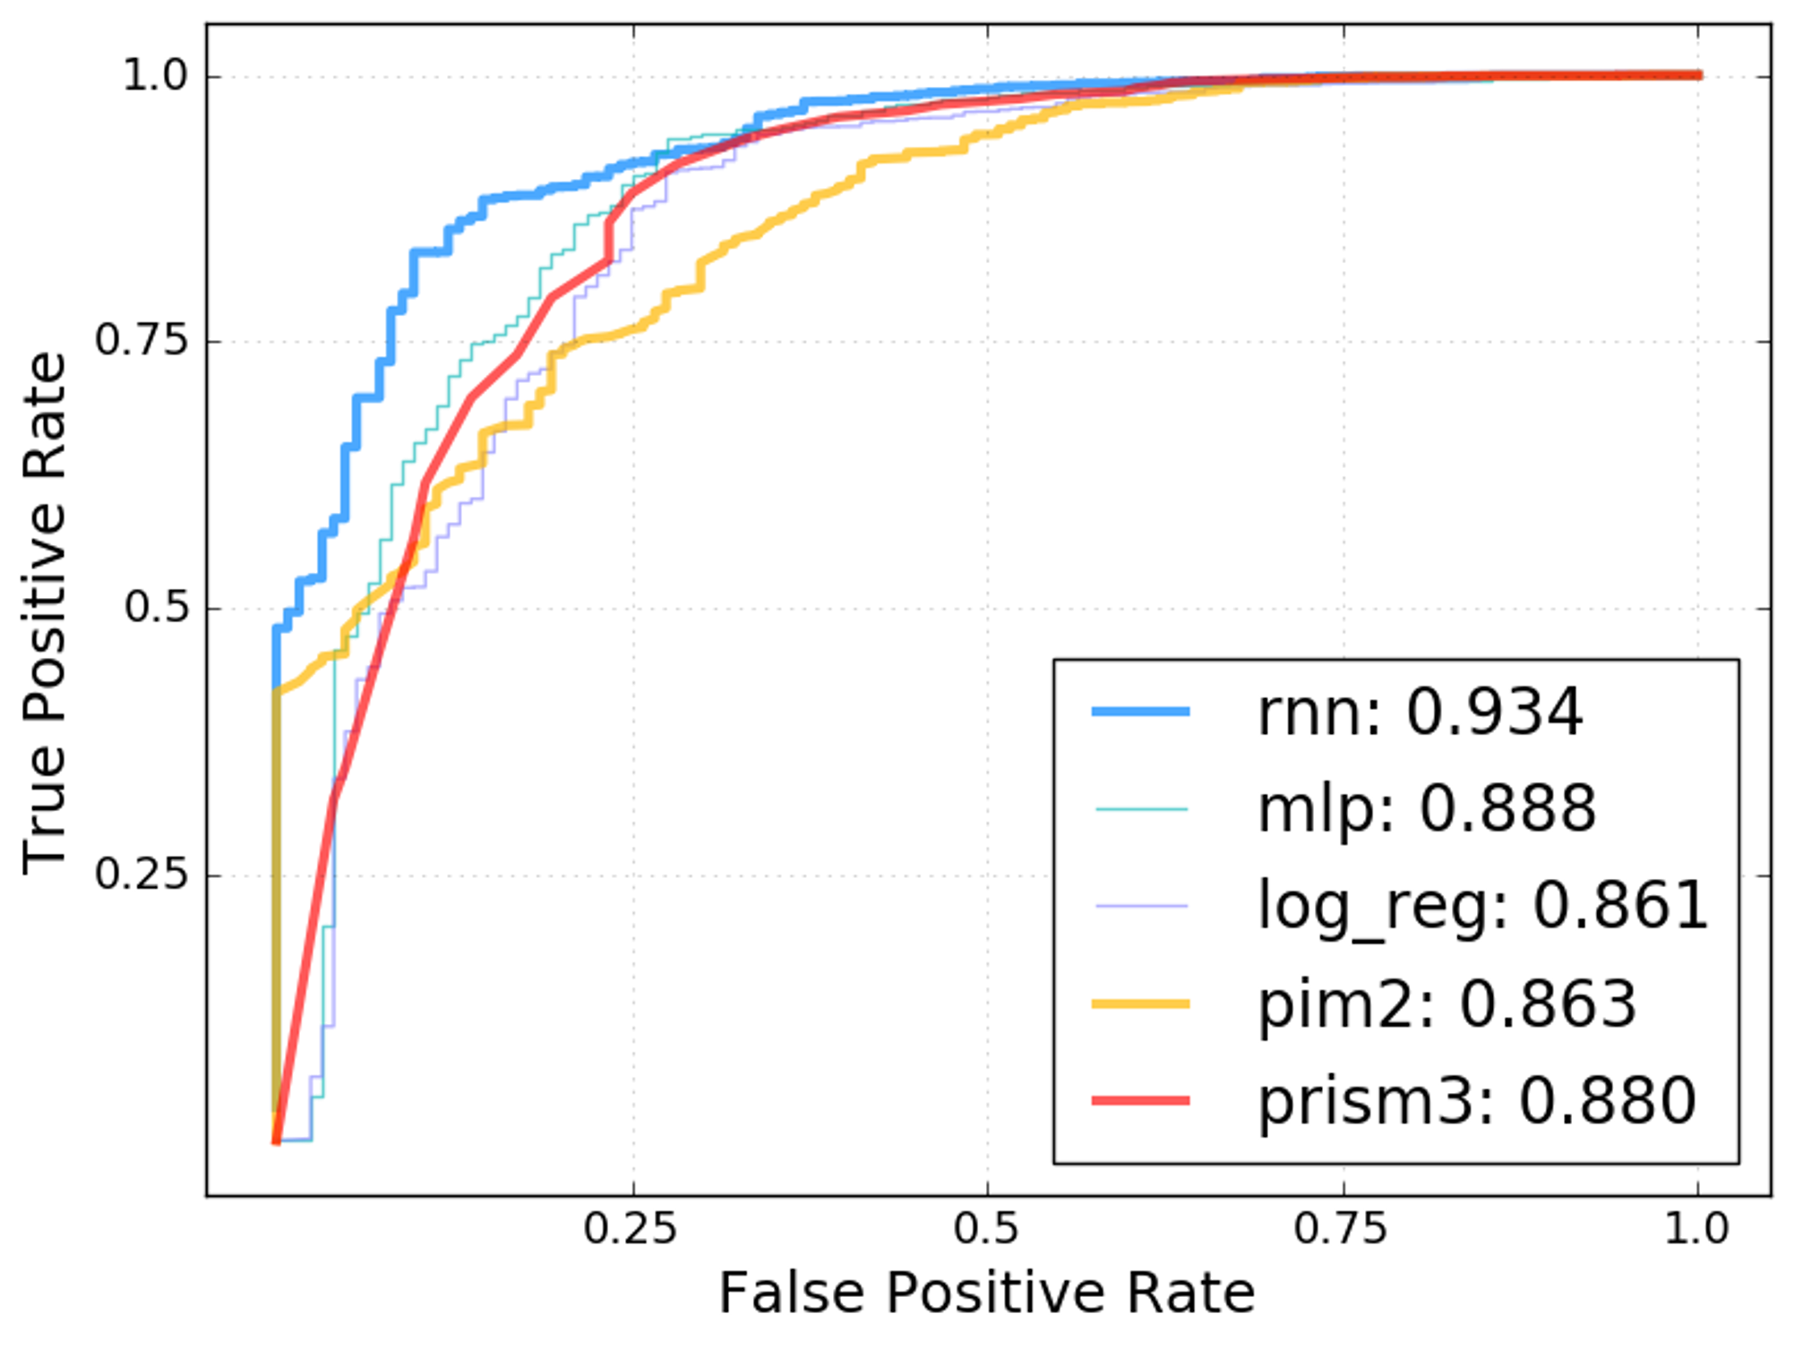
LAB REVIEW - COMPARE BASELINE #7

Slide 64
WHAT ELSE?
Many ways to explore and improve model:
Add a second and third LSTM layer to the network
Change the number of layers and the number of neurons in those layers
Change some of the meta parameters in the network configuration like dropout or learning rate, etc.
Try using a CNN? Does it outperform the RNN / LSTM model?

Slide 65
WHAT’S NEXT

Slide 66
WHAT’S NEXT
Use / practice what you learned
Discuss with peers practical applications of DNN
Reach out to NVIDIA and the Deep Learning Institute
Attend local meetup groups
Follow people like Andrej Karpathy and Andrew Ng

Slide 67
WHAT’S NEXT
TAKE SURVEY
ACCESS ONLINE labs
…for the chance to win an NVIDIA SHIELD TV.
Check your email for a link.
Check your email for details to access more DLI training online.
ATTEND workshop
JOIN DEVELOPER PROGRAM
Visit www.nvidia.com/dli for workshops in your area.
Visit https://developer.nvidia.com/join for more.

Slide 68
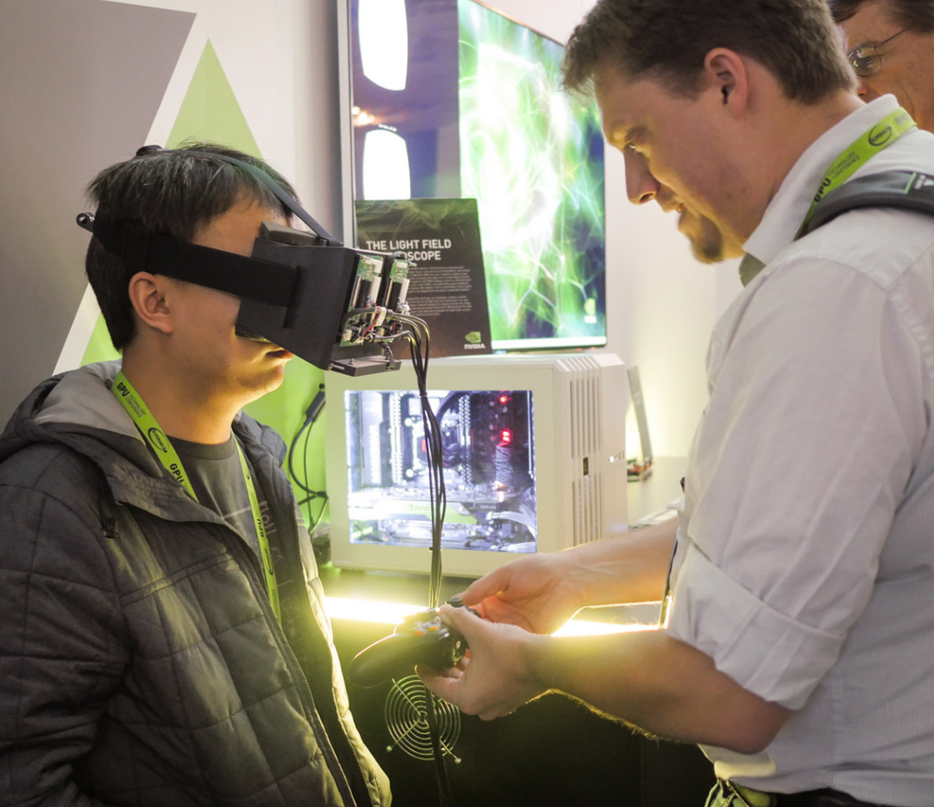
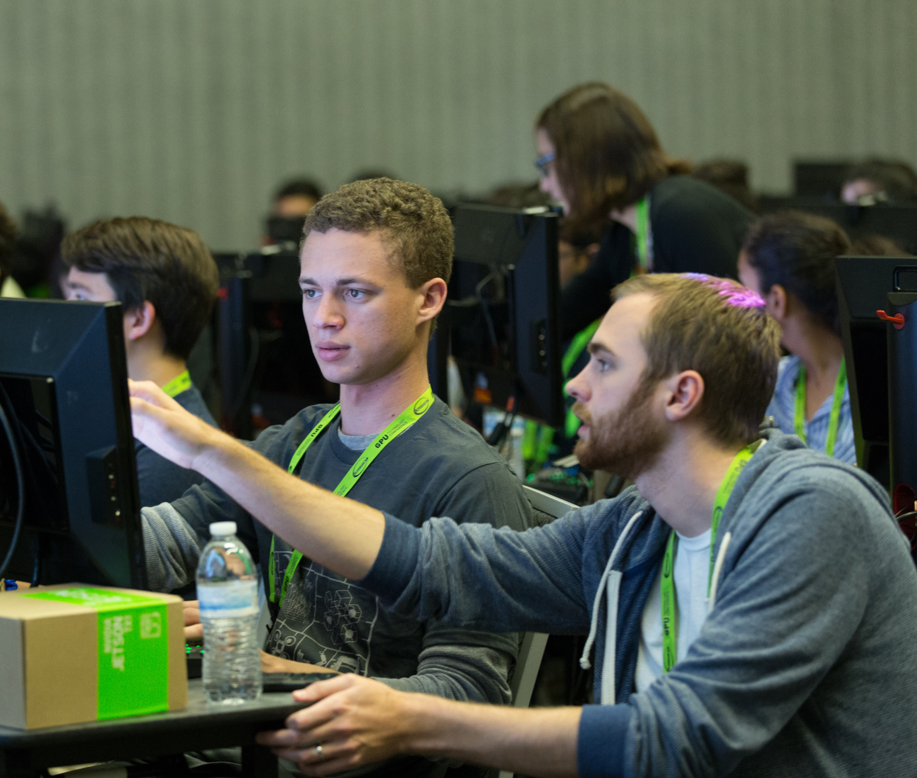
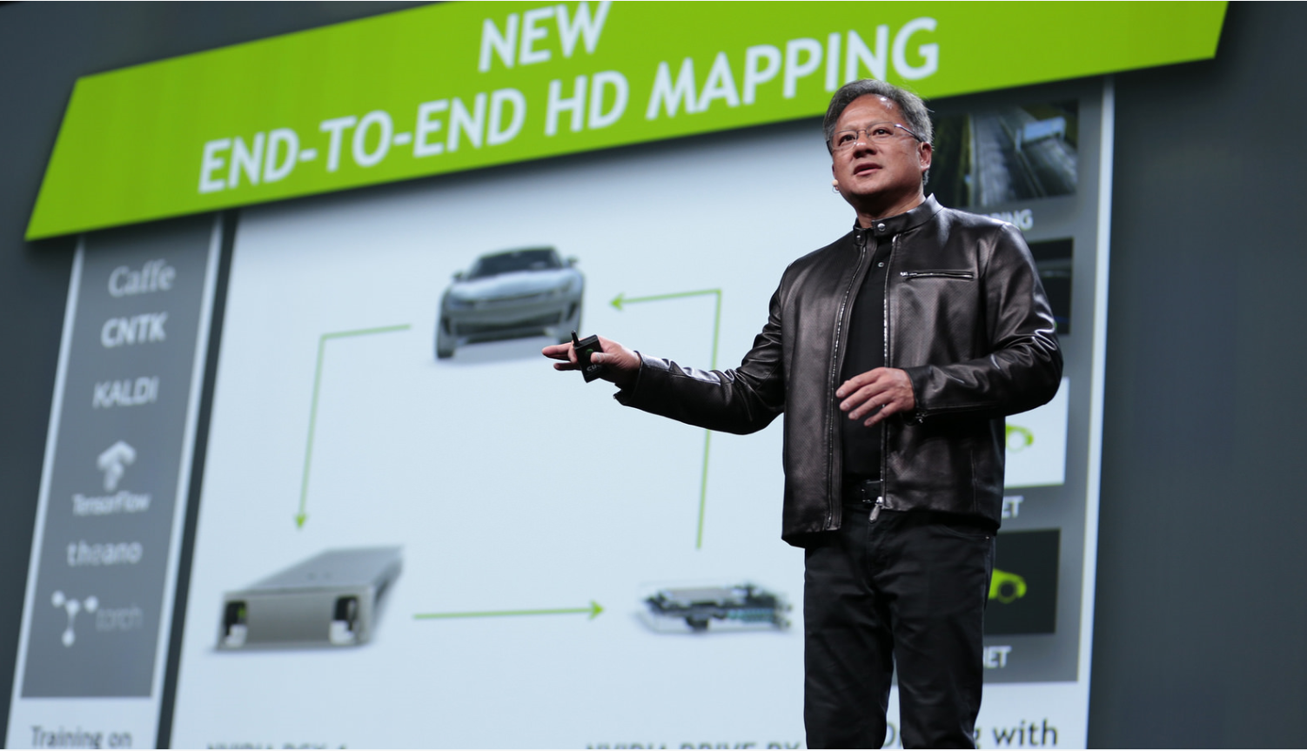
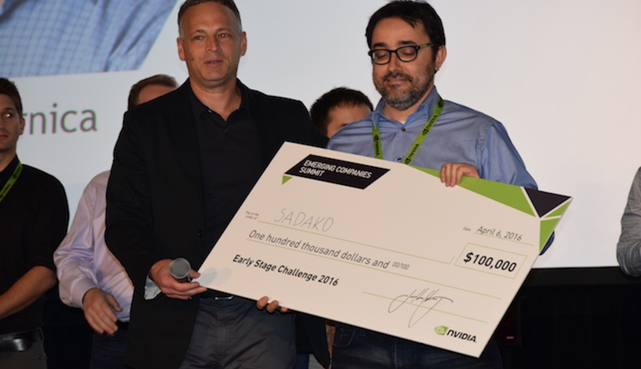
May 8 - 11, 2017 | Silicon Valley | #GTC17
www.gputechconf.com
CONNECT
Connect with technology experts from NVIDIA and other leading organizations
LEARN
Gain insight and valuable hands-on training through hundreds of sessions and research posters
DISCOVER
See how GPUs are creating amazing breakthroughs in important fields such as deep learning and AI
INNOVATE
Hear about disruptive innovations from startups
Don’t miss the world’s most important event for GPU developers
May 8 – 11, 2017 in Silicon Valley

Slide 69
Instructor:

